Slide 1

Agentic AI – Dynamic Business Reporting
Arun Thangamani

Slide 2
Quick Intro – About Me
Cloudera - Principal Solutions Architect
Resident Architect for AI and Data pipelines
Mastercard, Apple, Boeing, TMobile, SAP
Hulu/Disney, Medtronic, Wells Fargo, Microsoft
Open-Source Contributor
Apache HBase, Apache Oozie, Apache Ratis, Apache Tez (Hive)
Featured Session Speaker
Strata and DataSummit
ADP/CDK – Datalake founding Software Architect
100K Dealers, Dynamic website content through Click Stream Processing and ETL pipelines
Monsanto – Architect/Tech Team Lead
Big Data Architecture for future generation of seeds
Software Engineer – Yahoo
Education – MS Science – Computer Science – University of Alabama

Slide 3

Agenda
Dynamic Business Reporting Use case
Challenges in Use Case
Agentic AI
Architecture
LangGraph for True Agentic AI
Langfuse for Observability
Demo for Dynamic Business Reporting Use case
AI Agent Code Walkthrough
Business Impact & ROI at Scale
Langfuse Demo
Future Advancements – Scaling POC Code
Deliverables

Slide 4
Dynamic Business Reporting – Sales History Data Use Case
Products
Dimension
Customers
Dimension
Countries
Dimension
SALES
FACT
COSTS
FACT
Channels
Dimension
Promotions
Dimension
Times
Dimension

Slide 5
Dynamic Business Reporting – Sales History Data Use Case
Challenges without AI Agents
To answer just one of the important business questions :
Compare total sales in year 2000 to total sales in year 1999 and display Year-Over-Year Growth as a percentage
SQL query we may manually write is given below
This query scans the sales tables twice, does group by twice and does an additional left outer join, total 5 steps
AI agent with a trained LLM, can generate the same query to scan the table once, total 1 step
Per User it might take minutes/hours/days to write SQL for 100’s of business questions - depending on SQL knowledge
SELECT
CASE
WHEN t1.year = 2000 THEN (t1.amount_sold - t2.amount_sold) / t2.amount_sold * 100
ELSE NULL
END AS "Year-Over-Year Growth"
FROM (
SELECT
EXTRACT(YEAR FROM time_id) AS year,
SUM(amount_sold) AS amount_sold
FROM sh.sales
WHERE EXTRACT(YEAR FROM time_id) = 2000
GROUP BY EXTRACT(YEAR FROM time_id)
) t1
LEFT JOIN (
SELECT
EXTRACT(YEAR FROM time_id) AS year,
SUM(amount_sold) AS amount_sold
FROM sh.sales
WHERE EXTRACT(YEAR FROM time_id) = 1999
GROUP BY EXTRACT(YEAR FROM time_id)
) t2 ON t1.year = t2.year + 1

Slide 6
Agentic AI

Slide 7
Agentic AI
LLMs are systems that can generate text in response to a large text/prompt
They are stateless and trained models that can act as the “brain”
Agentic AI refers to artificial intelligence systems
Designed to pursue complex, open-ended goals autonomously.
Agentic AI systems can
plan
use tools
interact with external environments
adapt to changing circumstances until its objective is met
have long-term and short-term memory
Agentic AI with LangGraph
Stateful Framework for building complex cyclical graph AI applications/workflows
Not just sequential like LangChain
Nodes, Edges and Conditional routing
Built-in Persistence (state and checkpoints)
Allows AI to think, act, observe, loopback and retry if needed, produce output

Slide 8
AI Agent – Architecture with LangGraph and Langfuse
User/Python Script
Questions
entry
end
question → state
Cohere LLM
“command-r-plus-08-2024”
1) generate SQL
2) generate Summary Text
Oracle
Autonomous
Data Lakehouse
1) Give schema details
2) execute SQL
Answer/Error
LangGraph
state
checkpointers
get_schema
finalize_answer
schema → state
answer → state
Self correcting loop for generated sql with retry max
execute_sql
generate_sql
result, error, error_count → state
sql_query → state
Langfuse Observability Engine

Slide 9
Dynamic Business Reporting – Sales History Data Use Case
AI Agent’s Improved Query
Compare total sales in year 2000 to total sales in year 1999 and display Year-Over-Year Growth as a percentage
AI agent with a trained LLM generates a query which scans the sales table once, total 1 step & Aggregation
SELECT
CASE
WHEN SUM(CASE WHEN EXTRACT(YEAR FROM t.time_id) = 1999 THEN s.amount_sold ELSE 0 END) = 0
THEN 0
ELSE
(
SUM(CASE WHEN EXTRACT(YEAR FROM t.time_id) = 2000 THEN s.amount_sold ELSE 0 END)
-
SUM(CASE WHEN EXTRACT(YEAR FROM t.time_id) = 1999 THEN s.amount_sold ELSE 0 END)
)
/
SUM(CASE WHEN EXTRACT(YEAR FROM t.time_id) = 1999 THEN s.amount_sold ELSE 0 END) * 100
END AS "Year-Over-Year Growth"
FROM sh.sales s
INNER JOIN sh.times t
ON s.time_id = t.time_id
WHERE t.time_id BETWEEN TO_DATE('1999-01-01', 'YYYY-MM-DD') AND TO_DATE('2000-12-31', 'YYYY-MM-DD')

Slide 10
AI Agent Demo in OCI

Slide 11
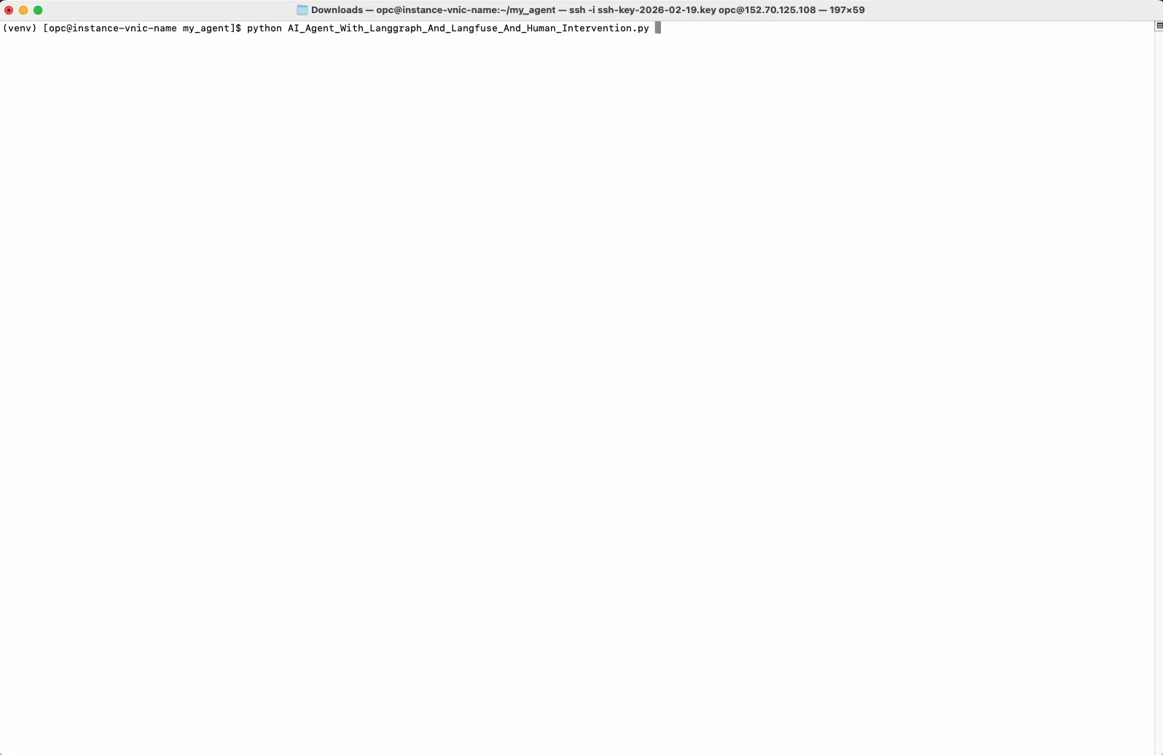

Slide 12
AI Agent Code Walkthrough

Slide 13
AI Agent - Business Impact & ROI at Scale

Slide 14
AI Agent – Business Impact & ROI at Scale
Proven Speed & Accessibility:
Answered 7 complex business questions in under 60 seconds.
True end-to-end natural language experience—zero SQL knowledge required by the end user.
Efficiency:
We just saw an example where the AI Agent took us from 5 steps to 1 step in internal query processing
Handles Complexity:
Built to navigate massive enterprise schemas (1,000+ tables) seamlessly.
Enterprise Scalability & Massive ROI:
Infinite Scale: Effortlessly supports hundreds of users asking thousands of questions.
The Bottom Line:
Reduces time-to-insight from days/hours to seconds/minutes
Freeing up incredibly valuable engineering and analyst resources
Freeing up compute resources

Slide 15
Langfuse Observability Demo

Slide 16
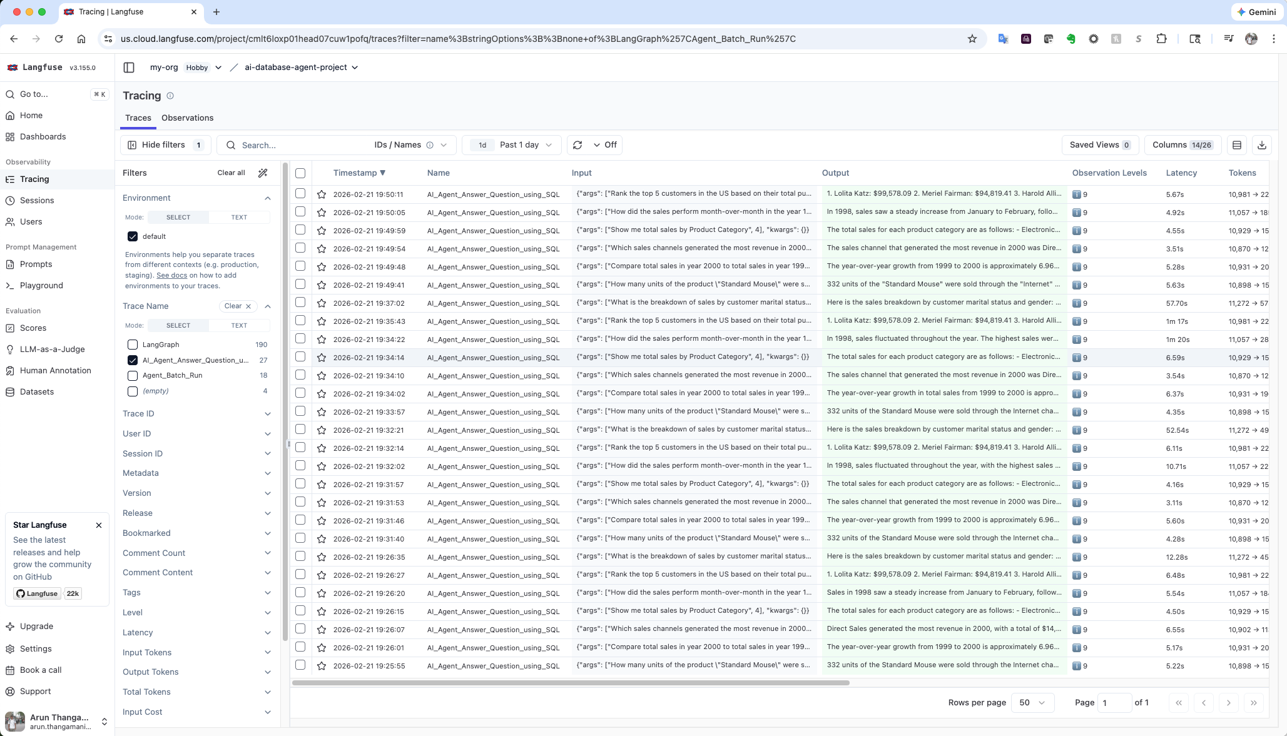
Langfuse Observability

Slide 17
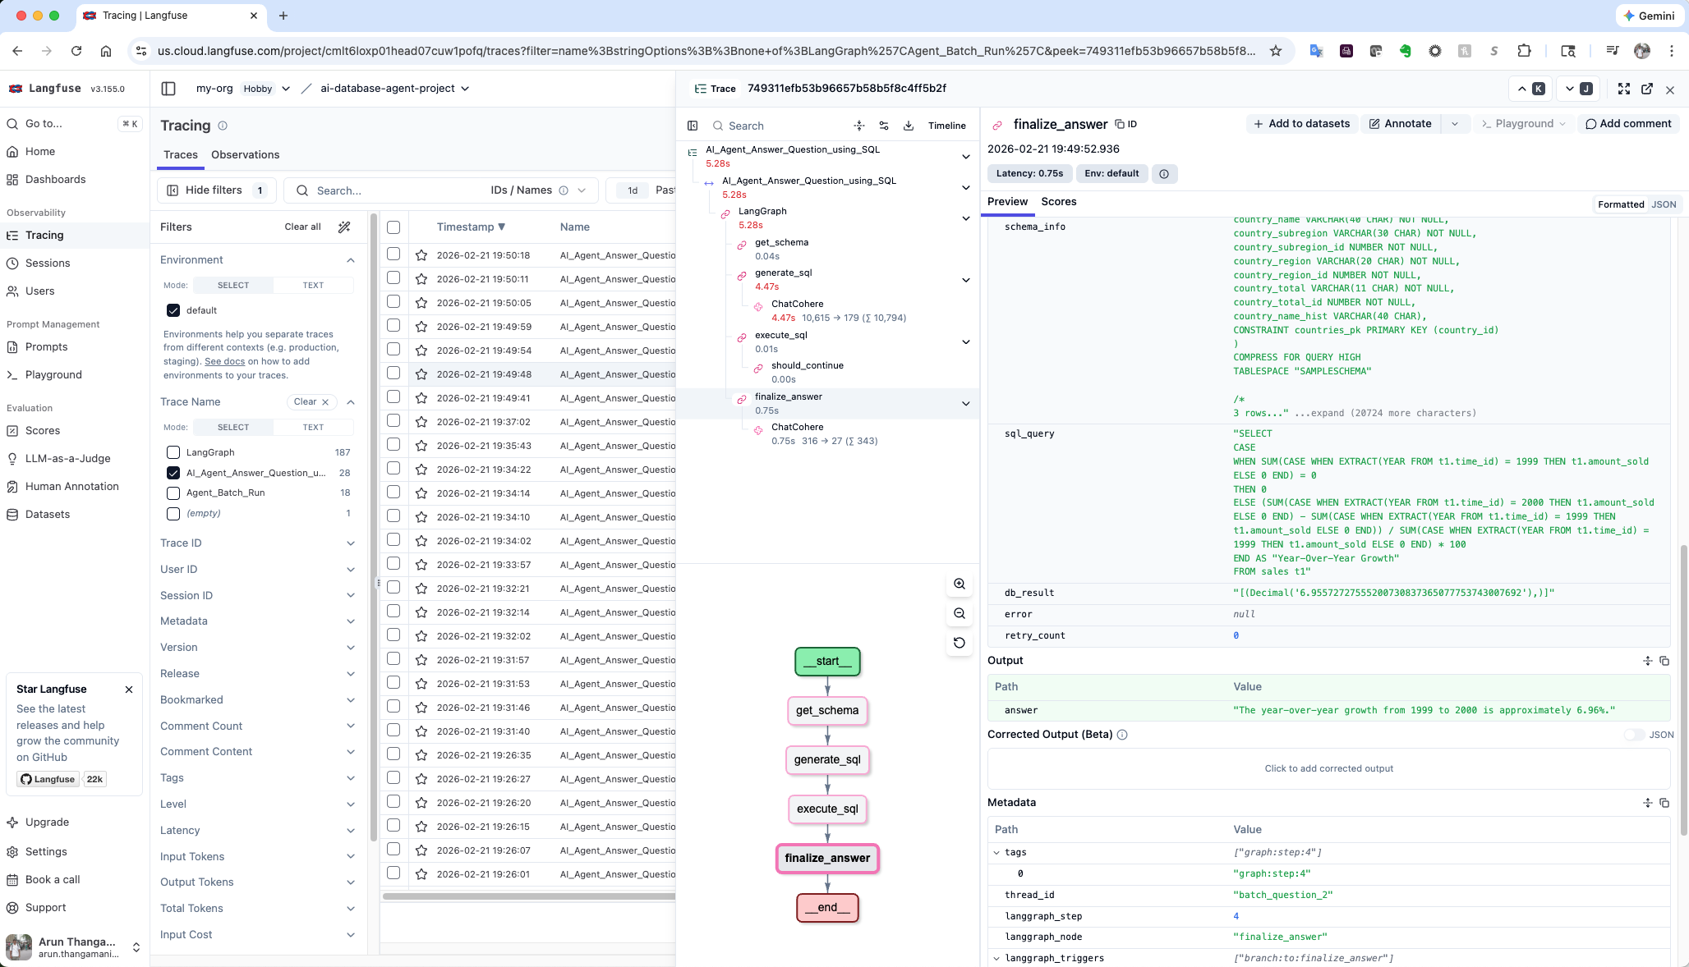
Langfuse Observability

Slide 18
AI Agent – Scaling POC Code

Slide 19
AI Agent – Scaling POC Code
Scaling
Build & Expose REST API around LangGraph
Fast API
Using Asynchronous Execution (astream)
Moving from app.stream to app.astream
Containerization and Cloud deployment
Compute instances, Database and LLM in the same region
External Caching
Using Redis, Memcache, etc
Modularization
Using MCP server if needed as a common interface
Governance
Better Authentication and Authorization models
Notes:
Langgraph using internal cache? Check this

Slide 20
Deliverables
https://github.com/athangamani/agentic_ai_with_langgraph/blob/main/README.md

Slide 21
Questions

